Slide 1

TSSM’s Bhivarabai Sawant College of Engineering and Research, Narhe-41
Department of Electrical Engineering
Project Stage-II
Academic year 2019-20
Presentation on
Battery Management System Of Electric Vehicle
Presented By
Mr. Tejas D. Sonawane
Mr. Girish Y. shinde
Mr. Mayur D Patil
Mr. Akash Bobade
Guided By
Prof. D. S. Sargar

Slide 2
Contents
Introduction
Problem Statement
Objective of project
Block Diagram
Four stacks containing 7 batteries each
Design Calculation
Simulation Explanation
Results
Pcb layout of arduino and batteries
Arduino circuit and specifications
Conclusion

Slide 3
Introduction
Electric vehicles (EVs) are expected to play an important role in sustainable mobility thanks to the efficient energy utilization and zero–emission when in use. The battery has a great impact on performance of electric vehicles and for determining the driving range which is important for user.
From today’s perspective, Lead acid chemistry is the battery technology of choice due to its good energy density, good power rating and charge/discharge efficiency in pulsed energy flow systems. Usually, a large number of cells, depending on the application, are series connected to build a battery string with the required voltage (up to 400 V).
Each battery cell cannot be identical, and therefore, each cell may be present with different voltages that will imply problems of protection to the cells. The chemicals depreciation process is needed to be reduced by suitable battery conditioning. This can be done by proper charging and discharging profiles, and a management system

Slide 4
PROBLEM STATEMENT
Reduce the temperature of battery when increased than a specified limit
Determination of current
Determination of voltage
Determination of soc
Arrangement of batteries
Protection of batteries and extension of their life

Slide 5
OBJECTIVES
1. Calculations of Battery ratings and selection of
batteries .
2. Calculation of SOC .
3. Displaying Battery parameters on display.
4. Controlling of battery and motor temperature by using
fan and water jacket.
5. Assembling of Display,fan,water jacket,controller and
alarm with other electrical vehicle parameter.
6. Testing of BMS on Stop and Running condition

Slide 6
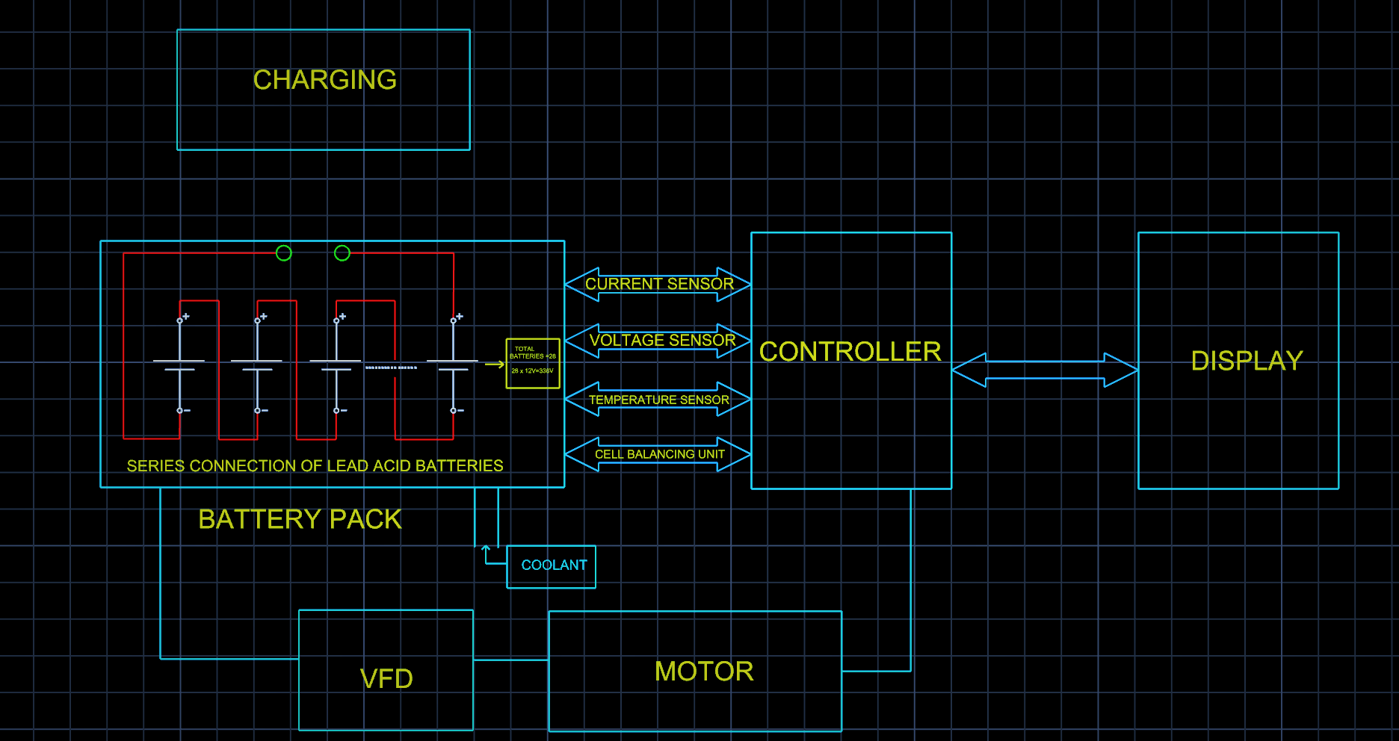
Block Diagram
Block Diagram Of Battery Management System Of Electric Vehicle

Slide 7
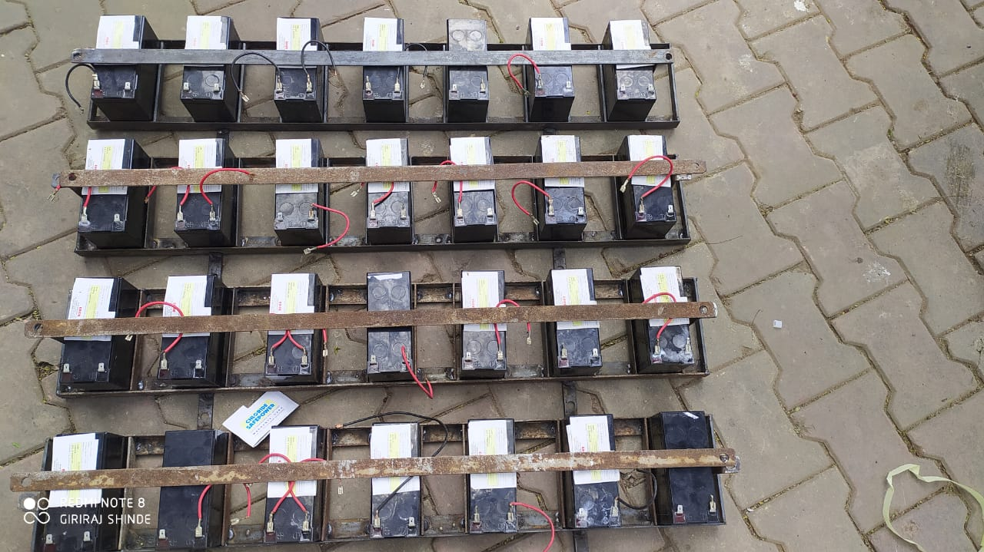
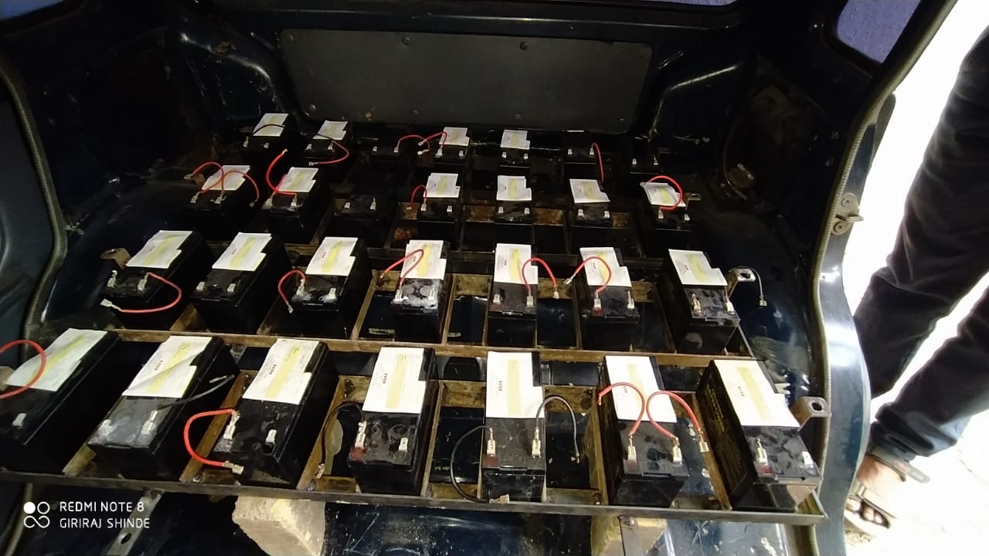
Four stacks containing 7 batteries

Slide 8
SOC CALCULATION
Lead acid batteries are made up of cells. Each cell is approximately 2 volts, so a 12­volt battery has 6 individual cells. It turns out that a fully charged 2­volt cell has a voltage of approximately 2.4 volts. Oddly enough, a fully discharged 2­ volt cell has a voltage of 1.9 volts. That’s only a difference of 0.25 volts on each cell from fully charged to fully discharged. So a 12­volt battery will measure at about 12.9 volts when it’s fully charged and about 11.4 volts when it is fully discharged
We Have Used 28 Batteries Of 12 V , 7Ah
When battery is full charged output voltage is 14.4 v
When battery is full discharged output voltage is 11.4 v.
CONDITION | VOLTAGE (V) | SOC (%)
FULL CHARGE | 403.2V | 100
FULL DISCHARGE | 313V | 0

Slide 9
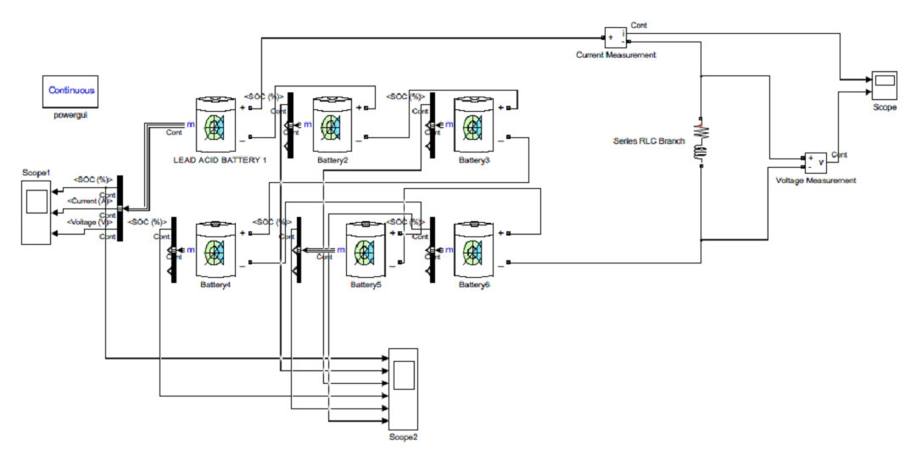
Simulation
Simulation Diagram Of Battery Management System Of Electric Vehicle

Slide 10
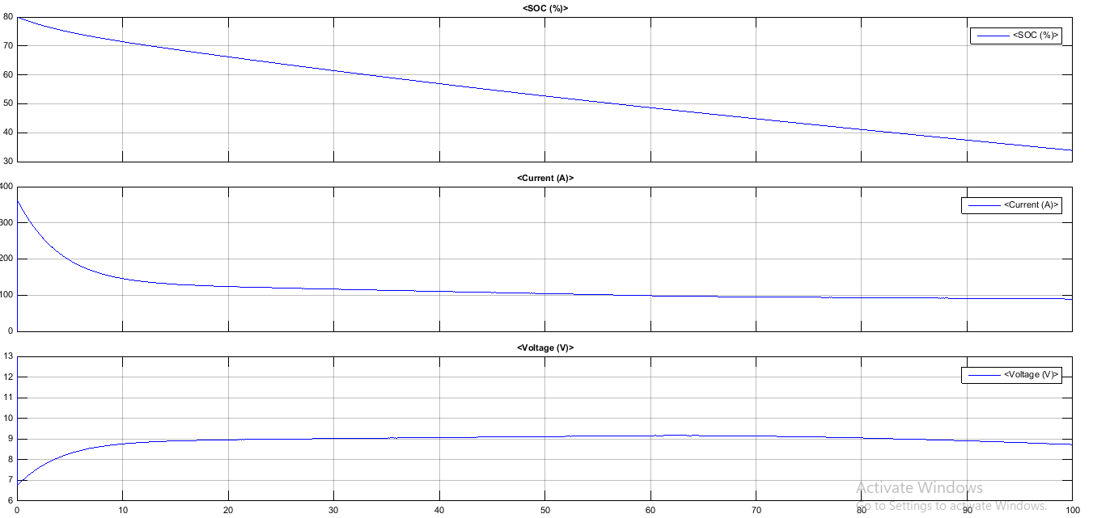
Simulation Results

Slide 11
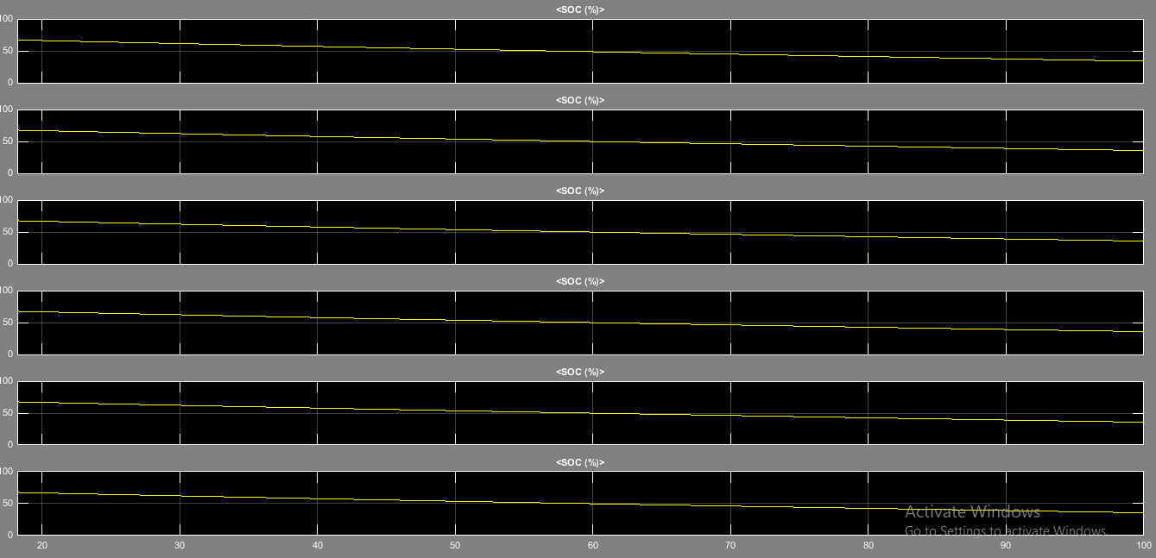
Simulation Results

Slide 12
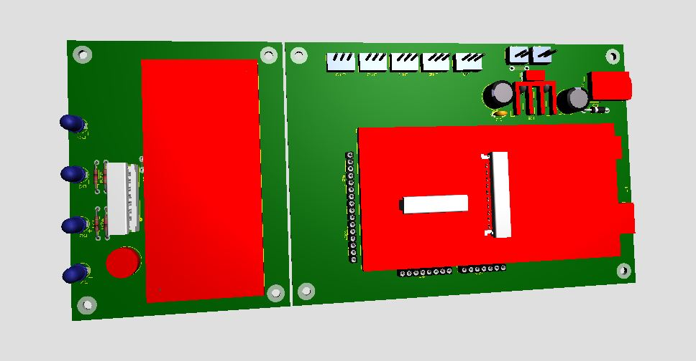
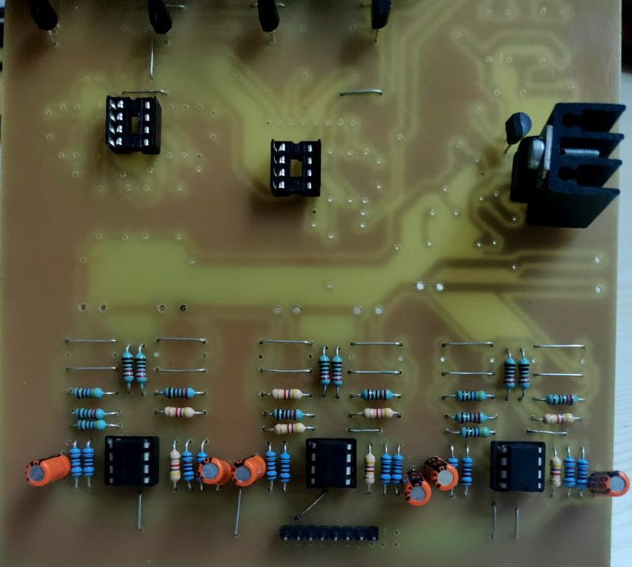
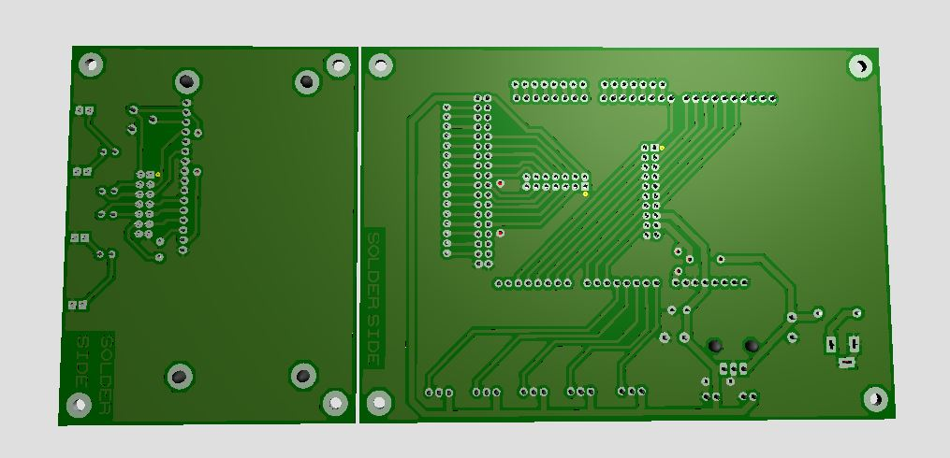
PCB LAYOUT FOR ARDUINO AND BATTERIES

Slide 13
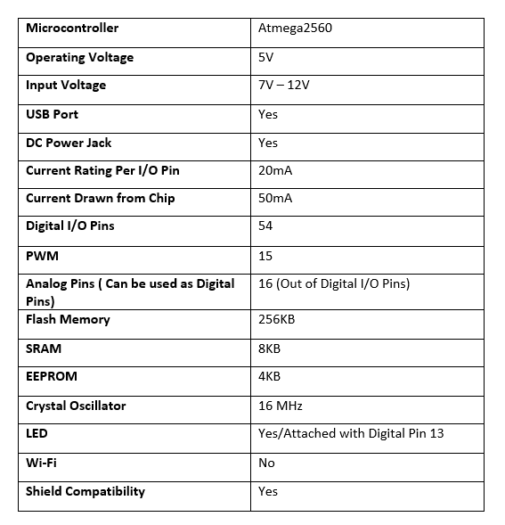
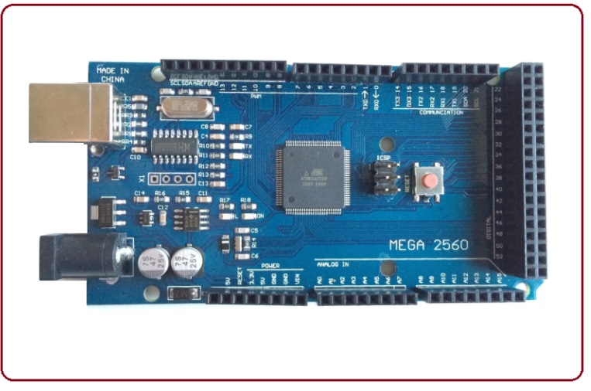
Arduino Mega 2560
Arduino Mega 2560 specifications
Arduino Mega 2560 Diagram

Slide 14
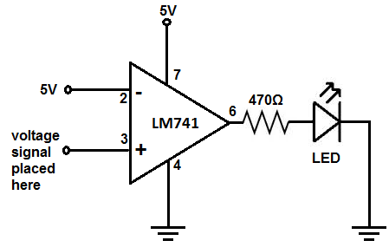
OPAMP
VOLTAGE SENSOR CIRCUIT
working
we have our reference voltage of 5V connected to the inverting terminal. This 5V forms our voltage threshold level. If the voltage at the non-inverting terminal is less than 5V, then the output will be off or LOW. If the voltage at the non-inverting terminal is greater than 5V, the output will be on or HIGH.
To the non-inverting terminal, we connect the test voltage signal we want to test.
How the circuit works is very basic. If the voltage at the non-inverting terminal is less, the LED is off. If it is greater, the LED turns on.
This is how we form a voltage sensor circuit based on any voltage value.
We can, of course, change the voltage anywhere from -15V to +15V.
If you want to be able to constantly vary the voltage, you can place a potentiometer either at the inverting terminal or non-inverting terminal or both and connect it to greater voltage to get a greater varying range.
VOLTAGE SENSOR CIRCUIT DIAGRAM

Slide 15
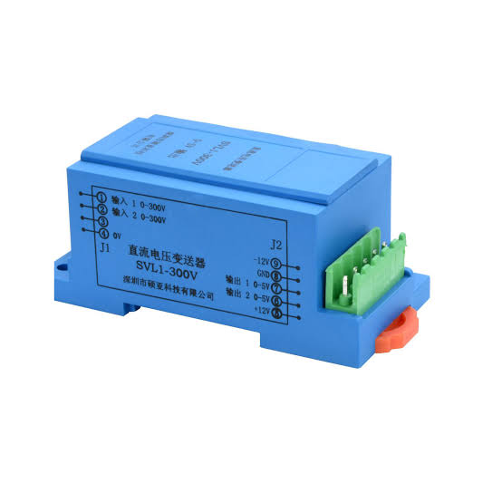
DC VOLTAGE SENSOR
DC VOLTAGE SENSOR
Specification
Sr no | parameter | Value
1 | Rated input voltage | 0-500 v DC
2 | Rated output voltage | 0-5volt
3 | Operating temperature | -20 to 85 Dg
4 | Response time | 300mS
The primary function of DC Voltage sensor is to detect and measure ac as well as dc level in the presence of voltage and it provide output to controller .The sensor are connected in parallel in batteries.

Slide 16
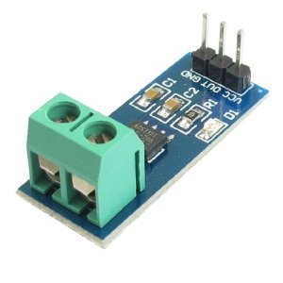
Current sensor
Specifications :-
Sr no | parameter | Value
1 | Current range | 35 amp
2 | Supply voltage | Up to 5.5v DC
3 | Sensitivity | 100 mV/A
4 | Rise time | 5 micro sec
Current sensor, to sense amount of current through a circuit, by sensing voltage drop across a resistor or voltage induced in a current carrying conductor. and it connection in series with the batteries.

Slide 17
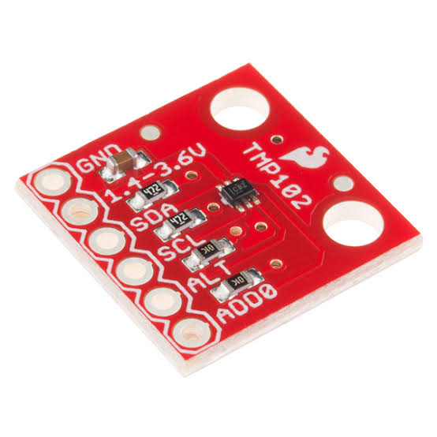
TEMPERATURE SENSOR
A temperature sensor is a device, typically, a thermocouple or RTD, that provides for temperature measurement through an electrical signal.
LM75 Temperature are used which allows maximum permissible temperature up to 27 degree Celsius.

Slide 18

Display unit
The term LCD stands for liquid crystal display. It is one kind of electronic display module used in an extensive range of applications like various circuits & devices like mobile phones, calculators, computers, TV sets, etc. These displays are mainly preferred for multi-segment light-emitting diodes and seven segments. The main benefits of using this module are inexpensive; simply programmable, animations, and there are no limitations for displaying custom characters, special and even animations, etc.it display voltage , current and temperature.

Slide 19
CONCLUSION
FROM The above simulation it is conclude that SOC depends on battery voltage has voltage decreases SOC also decreases below 10.5 volt degradation of battery occur.

